Slide 1
Secure Data Hiding In Images Using Steganography
CAPSTONE PROJECT
Presented By: Shwetha
Student Name: Shwetha
College Name: Mangalore Institute of Technology & Engineering
Department : Information Science & Engineering

Slide 2
OUTLINE
Problem Statement
Technology used
Wow factor
End users
Result
Conclusion
Git-hub Link
Future scope

Slide 3
Problem Statement
Traditional encryption methods can be easily identified, leading to potential suspicion.
A secure approach is needed to hide confidential information within images.
It is crucial to maintain the integrity of the cover image while protecting the data.
Encryption and decryption processes should be simplified for non-technical users through an intuitive interface.

Slide 4
Technology used
Programming Language: Python
Image Processing Library: OpenCV
Graphical User Interface (GUI): Tkinter
File Handling & Security: Basic encryption logic for password protection
Platform: Windows 11

Slide 5
Wow factors
Utilizes steganography to discreetly embed messages within an image, ensuring no visible alterations.
Features an intuitive graphical interface for effortless encryption and decryption.
Employs lossless data hiding by manipulating pixel values rather than relying on conventional cryptography.
Compatible with all standard image formats, with PNG being the recommended format for optimal results.

Slide 6
End users
Cybersecurity Enthusiasts – Investigating advanced methods of secure communication.
Government & Defense – Ensuring discreet message delivery without drawing attention.
Journalists & Activists – Hiding sensitive data within images to protect against surveillance.
Software Developers – Gaining knowledge about steganography and its real-world applications.
Businesses & Enterprises – Protecting confidential corporate data through hidden image messages.
Educators & Researchers – Studying steganography as a tool for secure information sharing and privacy protection.

Slide 7
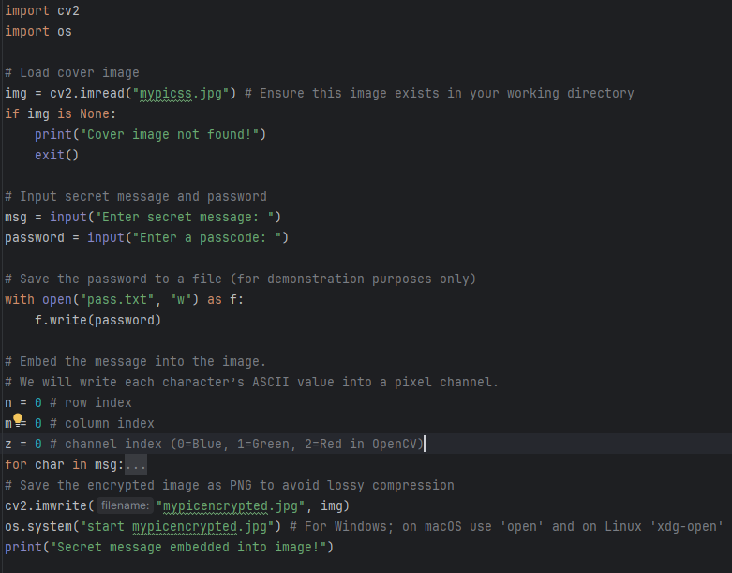
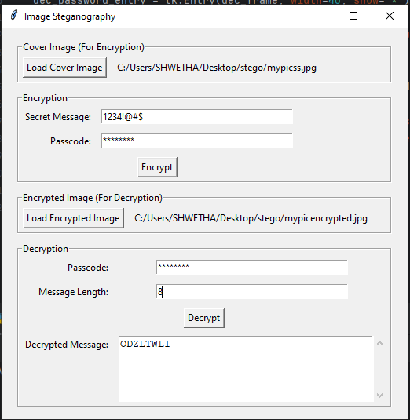
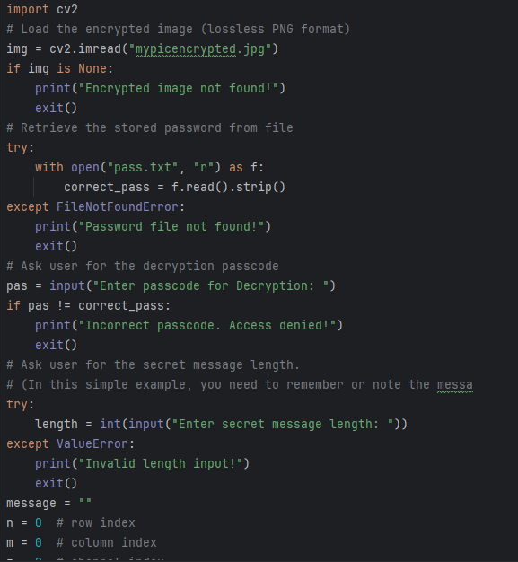


Results
Encryption Code:
GUI:
Decryption Code:
Input Image File:
Output Image File:

Slide 8
Conclusion
Steganography offers a hidden method for transmitting confidential messages.
This project demonstrates a straightforward and efficient approach to embedding messages within images.
The user-friendly interface ensures that both technical and non-technical individuals can easily encrypt and decrypt messages.
Future enhancements could focus on increasing the system’s security, resilience, and scalability.

Slide 9
GitHub Link
https://github.com/Shwetha-Mohananda/Steganography.git

Slide 10
Future scope
Advanced Encryption Methods – Implement AES encryption before embedding text within images for added security.
Support for Audio & Video Steganography – Extend capabilities to hide messages in audio and video files.
AI-Driven Detection Prevention – Utilize AI to prevent detection by advanced forensic tools.
Mobile & Web Accessibility – Offer mobile and web versions to increase accessibility beyond desktop platforms.
Multi-Layer Security – Combine steganography with blockchain technology for enhanced, secure communication.
Real-Time Encryption – Enable live encryption and decryption of media for instant secure messaging.
Cross-Platform Compatibility – Ensure the solution works seamlessly across multiple devices and operating systems.

Slide 11
THANK YOU

